Slide 1
Detection of Diabetic Retinopathy using deep learning
HeonHyung Lee
May 21, 2019

Slide 2
Data set (graded by ophthalmologist)
For Development – From EyePACS in US and India, obtained among patients who were considered to have diabetic retinopathy
For clinical validation – From EyePACS, a deidentified data set consisting of a random sample of macula-centered images that didn’t overlap with the development one.
And, Messidor-2 data set, publicly available.
Have to try to use Messidor-2 data set as a novice.
(since it’s public they say)

Slide 3
Grade
Ophthalmologists have graded these data sets for the presence of diabetic retinopathy, diabeti macular edema, and image quality with high inter-intragrader reliability.
The severity range is from none, mild, moderate, sever, to proliferative.
In terms of macular edema, the criteria is any hard exudates(삼출액) exist or not.
In terms of Image quality, excellent, good, and adequate were considered gradable.

Slide 4
Algorithm
Computes diabetic retinopathy severity from intensities of the pixels in a fundus image.
To train this function, needed large set of images about severities which already known. and initialized with random values.
After that, for each image, the grade is compared with the known grade from training set. and parameters of the function are modified to decrease the error on that image.
They used the convolutional neural network(나선형, 합성곱 네트워크) that uses a function that first combines nearby pixels into local features then aggregates those into global feature.
The specific network is Inception-v3 that I have to study. And they used Scipy and StatsModels version 0.6.1

Slide 5
Performance of algorithm
They measure the performance using AUC that an area under the receiver operating curve(이진 분류 시스템의 주된 평가 기법) which’s x axis is 1-specificity and y axis is sensitivity.
FYI) specificity is True Negative, sensitivity is True Positive.

Slide 6
Result
After 60,000 images, the algorithm performance was stuck like on plateau.
Conclusion : deep neural networks can be trained and used to identify diabetic retinopathy or macular edema with high accuracy. sensitivity was 97.5%.
But it’s hard to know the exact features being used. But it could also be an advantage that makes possible to use features previously unknown.

Slide 7
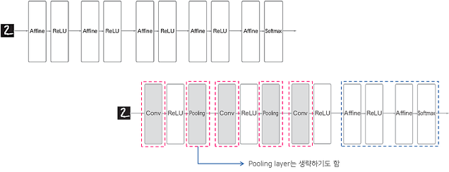
Convolutional neural network. -합성곱 신경 네트워크
Network consisting of Affine layer – Fully connected layer
Convolutional neural network.

Slide 8
Fully connected versus convolutional.
Usually an images has 3 dimensions; height, width, channel(color).
Fully connedted network ignores the shape of data and makes it 1 dimension.

Slide 9
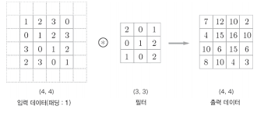
Convolutional product
filter used as weight and
Move as a window and
Sum of The outcome of product
the overlapped cell is output data.
this process is named “fused-multiply-add” (FMA)
In this case, input data adopted 1 padding, meaning of empty cells around numbers to make the output size same to input’s.

Slide 10
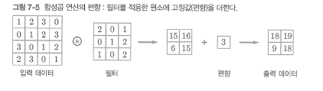
Cont’d
After processing filter, it is added with bias ,the 1x1 cell.
FYI, Stride is how many cell the window jumps.

Slide 11
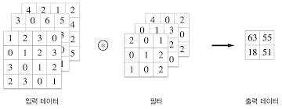
3 dimensions convolutional product
Images have 3 dimensions. So we have to add one more dimension, Channel.
The process is same to before. But the number of the input’s and filter’s channel must be same.

Slide 12
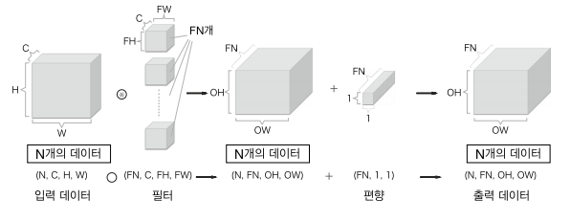
Multiple output
To make multiple output, needed to use multiple filter channel.
each box on the below represents one process
C : Channel, H : Height, W: Width and
N : number of input or filiter or output

Slide 13
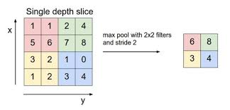
Pulling layer
To reduce height or width, needed to use pulling process.
There are 2 ways to remove the cell
- first : take MAX value of the window.
- second : take average value of the window
In below case, window is 2x2, and stride is 2.

Slide 14
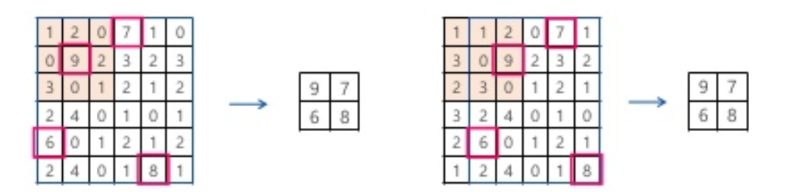
Cont’d
Pulling doesn’t mean learning, it just reduce the cell.
And It makes no change of the number of output channels.
Finally, it is kind of strong against change of input data.

Slide 15
Need to do
I should study the Inception they used and try to run using public data, Messidor-2.
I have to study over the article meticulously. Since there is a lot of things I wasn’t able to understand.
DongWoo and I should find another tool or algorithm instead of Inception.
Try to learn how to use Scipy they used as a tool in the article.
Foremost, I have to learn what is deep learning actually.

